Slide 1
Development of Simulation Algorithm for Online Electrical Measurements Lab
By:
Shivam Yadav, Satyam Yadav, Shubham, Rohit Pal, Anjani Kumar Tiwari
(Electrical Engineering, UG III Year)
Under the supervision of
Prof R.S. Anand
Notes:
shubham + all

Slide 2

Contents
About the project 3-4
Design and development 5-6
Simulated Experiments 7-9
Simulation 10-11
Simulation Results 12
Conclusion 13
References 14
Notes:
shubham

Slide 3
About the project
Purpose of the project is to develop a simulation algorithm which provides a virtual environment of the electrical measurement lab.
Includes various web-framework which are discussed in upcoming slides.
Project includes experiments involving bridges like Wheatstone, Carey
Foster, Maxwell, Owen and few more.
Can be used in online courses that involves practical component and also when there is resource constraint.
Notes:
shubham

Slide 4
Design and Development:
Web-framework used here includes HTML5, CSS, Javascript, jquery and jsPlumb Toolkit.
Also tried schemdraw which is a python package for producing high-quality electrical circuit schematic diagrams.
Since it was for static content, we shifted to jsPlumb toolkit which helped us in dynamic simulation of the circuits.
We are using jsplumb that ensures the user gets the feel of making circuit connections in real-time.
There is a algorithm ensuring that the circuit connections made by users are valid and functional.
Notes:
satyam + anjani

Slide 5
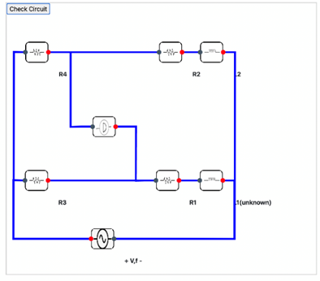
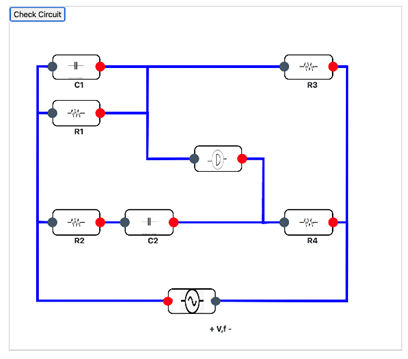
Simulated Experiments
Fig: Maxwell Bridge
Fig: WR Frequency Bridge
Notes:
Shubham

Slide 6
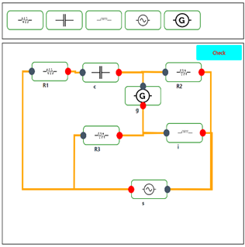
Fig: Hays Bridge
Notes:
Satyam

Slide 7
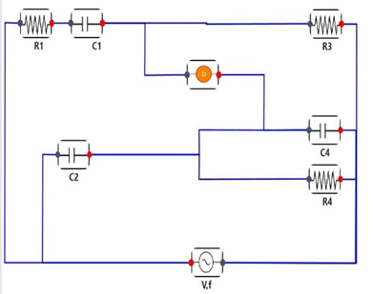
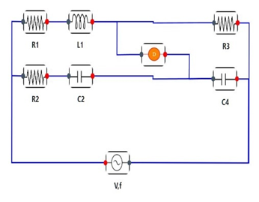
Fig: Owen’s Bridge
Fig: Schering’s Bridge
Notes:
Anjani

Slide 8
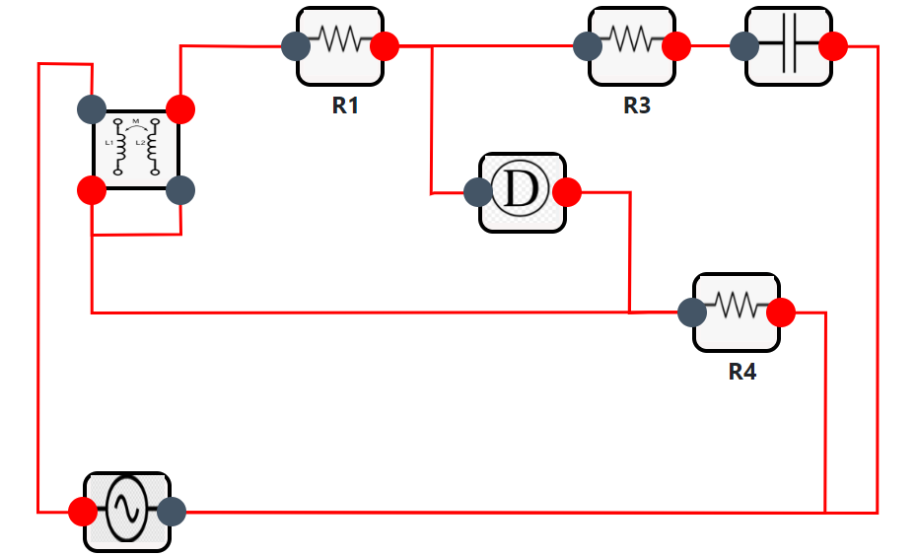
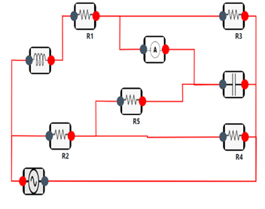
Fig: Anderson Bridge
Fig: Carey Foster Bridge
Notes:
Rohit pal

Slide 9
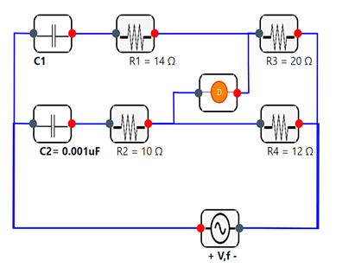
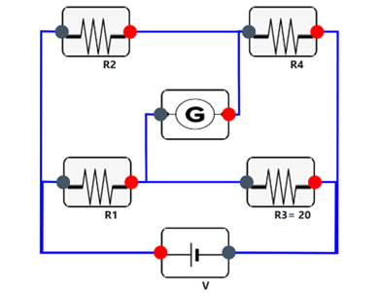
Fig: Wien’s Series Bridge
Fig: Wheatstone Bridge
Notes:
Shivam

Slide 10
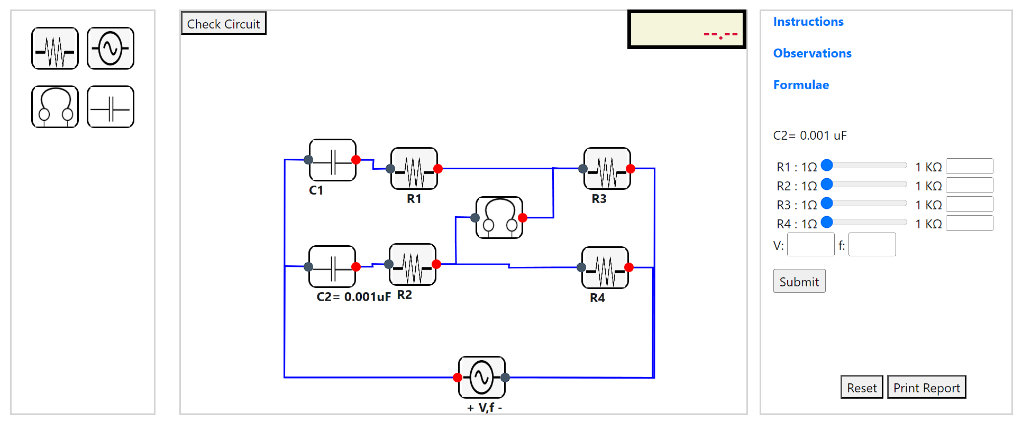
Simulation
Notes:
Shubham(little bit) then satyam

Slide 11
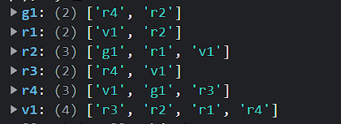
Methodology
Connections: target & source
Map of connections:
Checking connections of each element with original circuit.
Taking user input
Notes:
Shivam+Rohit

Slide 12
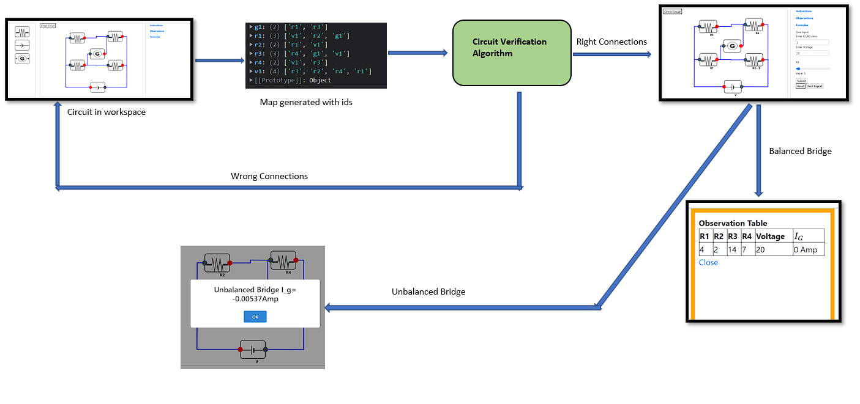
Contd…
Notes:
Anjani

Slide 13
Uniqueness in the project…
Dynamic circuit simulation with drag and drop.
Simultaneous changing of labels value
audio detector
printing the report and submit for evaluation
Light weight, fast and easy to use.
Notes:
Satyam

Slide 14
Conclusion
Numerous research studies have focused on the benefits and importance of virtual lab.
Students are prone to electric shocks and sometimes they do not handle equipment properly.
User can simulate the circuit in real time.
Added observation table, instructions, formulae used, verifying algorithm and a print button to obtain report.
Further work include remaining experiments, showing current through galvanometer through needle deflection, rotation of elements.
Notes:
Rohit+Shubham

Slide 15
References
Yang, Woong Lee, Soo-Hong Zhu, Jin Hwang, Hyun-Tae. (2016). Development of Web-based Collaborative Framework for the Simulation of Embedded Systems. Journal of Computational Design and Engineering. 3. 10.1016/j.jcde.2016.06.004
https://journals.sagepub.com/doi/pdf/10.1177/0020720918775041
https://docs.jsplumbtoolkit.com/community
https://medium.com/@priyeshayadav9192/creating-a-dynamic-flow-diagram-using-jsplumb-with-angular-ec1f317f892a

Slide 16
Thank
You

